Slide 1
City Facilities Management
Mass Mutual
Whole Life with Chronic Care Benefits
Initial Enrollment

Slide 2
Great News! New Benefit Option!
Mass Mutual Whole Life with Chronic Care Benefit.
Chronic care benefits allow you to advance up to 75% of the face amount while you are alive if you lose two or more activities of daily living. You can use this money to help with long term care expenses.
Survivor Benefits | Chronic Care Benefits
Pays a lump sum to your beneficiaries to help pay for your funeral, pay off your mortgage or other important family expenses. | Living benefit that pays a lump sum to you if you lose two or more activities of daily living.

Slide 3
Chronic Care Rider
A severe car crash can require the need for long term care. These services cost hundreds of dollars per day. The average cost of a six hour visit by a home health aide is $126. That’s $32,760 per year for care five days a week.
Statistics show:
70% of the population will need some form of long-term care in their lifetime.
Only 8% of the population has long term care coverage.
Average annual cost for private nursing home was just over $100,000.
40% of claims come from individuals who are still in their working years (18-64)

Slide 4
Mass Mutual Whole Life Product Highlights
Coverage
Eligible employees, spouse, children & dependent grandchildren
Guarantees
Guaranteed face amount
Guaranteed level premiums
Guaranteed cash value accumulation
Dividend eligible
Accelerated death benefit
Chronic illness
Permanent loss of two activities of daily living
Severe cognitive impairment
Lump sum payment (Up to 75% of death benefit)
Terminal illness
Diagnosed with terminal illness with less than 12 months to live
Portable, lifelong coverage

Slide 5
No Medical Questions
This is your one-time offer to enroll without any medical questions.
You'll be able to lock in your guaranteed issue offer if you get your foot in the door at this year's enrollment.
Getting your foot in the door at this year’s enrollment allows you to increase without medical questions at future enrollments.
If you do not enroll at this enrollment, and wish to enroll at a future enrollment, there are medical questions to enroll. You may be turned down if you decide to wait and enroll at a future enrollment.

Slide 6
Group Life Overview
Many employees rely on their group term life insurance, and they outlive it. Whole life does not expire. As long as the employee pays their premium, they can’t outlive it and it will do what it is supposed to do and pay when they need it.
 | Basic term life | Supplemental term life | Whole life
Employer paid | Yes | No | No
Level premium | Employer paid | Increases | Yes
Age reduction applies | Yes | Yes | No
Coverage ends | Termination | Termination | Lifetime coverage
Long term care benefits | No | No | Yes

Slide 7
Eligibility
Age based on the certificate date of 9/1/25. Interim coverage provided.
Eligible | Details
Employee | Actively at work, full time (30 hours per week) Issue ages 18-75 on certificate date
Spouse | Issue ages 18-60
Children/Grandchildren | Issue ages 14 days – 26 years

Slide 8
Mass Mutual Plan Design
Benefit | Details
Face amount | $10,000-$250,000 increments of $5,000
Lifetime max | $1,000,000 from all certificates
Dividend eligible | Yes. Dividends are not guaranteed
Waiver of premium | 10% of base premium
Accidental death benefit | 1x face amount ($0.84 per thousand)
Terminal illness rider | Diagnosed with an illness that will result in death within 12 months.
Chronic illness rider | Permanent loss of two activities of daily living, or requiring substantial supervision due to permanent severe cognitive impairment.

Slide 9
Mass Mutual Underwriting Offer
Participation requirement: Each employee needs to enroll or decline. 10 employee application minimum.
Applicant | Underwriting | Amount
Employee | Guaranteed issue (Foot in the door provision) | $150,000
 | Express issue | $250,000
 | Lifetime max (all certificates) | $1,000,000
Spouse | Express issue Employee must elect $25,000 or more Can’t be disabled or receiving disability | $25,000
Children/ Grandchildren | Guaranteed issue Employee must elect $25,000 or more Can’t be disabled or receiving disability | $25,000

Slide 10
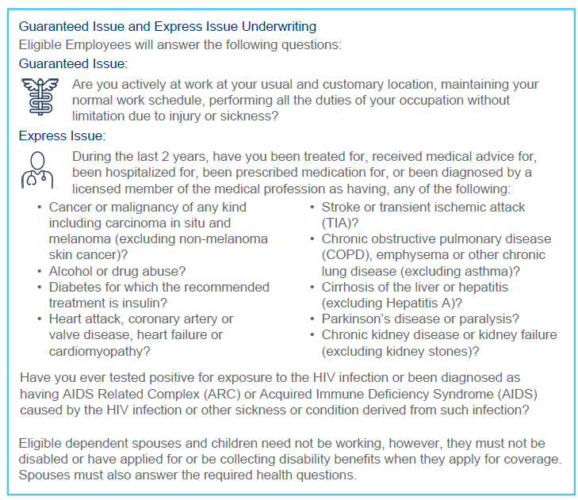
Mass Mutual Whole Life Express Issue Question

Slide 11
Sample Weekly Rates
Non-smoker weekly rates. Issue age rates. Portable at the same rates.
For your specific weekly rates, visit totaliscbs.com/city
Disclaimer: These pages are just a summary of the offer from Mass Mutual. Every attempt has been made to ensure they are correct.
Issue Age | $25,000 | $50,000 | $75,000 | $100,000
35 | $7.20 | $13.37 | $19.55 | $25.73
45 | $11.38 | $21.75 | $32.12 | $42.49
55 | $19.19 | $37.36 | $85.39 | $73.71
65 | $29.08 | $57.23 | $106.20 | $113.54

Slide 12
Special Underwriting Offer
One time "no medical questions" offer
Eliminates medical questions for eligible employees
Can’t get this offer on their own
Employees may have difficulty getting coverage
Medical conditions may result in being turned down or charged a higher rate on the individual market
Lock in guaranteed issue for future enrollments
Foot in the door provision
Get a small amount of coverage now and have the ability to raise the amount at a future enrollment regardless of health
Elimination of medical questions is a partnership with the insurance company, the employer and the employee.

Slide 13
Action Requested
Even if you may not be interested in enrolling, please review the offer and enroll or decline the benefit option in the enrollment platform or with a benefits counselor.
This helps each employee get guaranteed issue at this enrollment.

Slide 14
Enrollment Date!
Mass Mutual open enrollment begins August 4.
You'll be receiving enrollment reminders via email and text.

Slide 15
How to Enroll (or Decline)
Self enroll (Available now)
Enroll by phone
By appointment (Appointments are limited, start scheduling today)
Direct call in (Available August 4)
M-F 9am-6pm ET
Visit: totaliscbs.com/city

Slide 16
Questions?
?
We look forward to helping you and your employees during this special enrollment period.

